Slide 1
Topic 3.2
Greedy Technique

Slide 2
The greedy approach is one of the techniques that follow the divide and conquer strategy. This technique is used for decoding optimisation problems.
It’s a method for decoding a problem by choosing the best alternative open at that point.
This algorithm doesn’t worry whether the existing and most satisfactory result will obtain the overall optimal result.
An algorithmic paradigm based on heuristic that follows local optimal choice at each step with the hope of finding global optimal solution

Slide 3
ADVANTAGES | DISADVANTAGES
The concept of a greedy algorithm is clear and straightforward. | They frequently fail to provide the best answer or solution.
This algorithm performs better than others in terms of efficiency
FEATURES
A candidate set − A solution is created from this set. • A selection function − Used to choose the best candidate to be added to the solution. • A feasibility function − Used to determine whether a candidate can be used to contribute to the solution. • An objective function − Used to assign a value to a solution or a partial solution. • A solution function − Used to indicate whether a complete solution has been reached.

Slide 4
Shortest Paths in Graphs
Consider a weighted directed graph
Each node x represents a city x
Each edge (x, y) has a number which represent the cost of traveling from city x to city y
Problem: find the minimum cost to travel from city x to city y
Solution: find the shortest path from x to y

Slide 5
Given a weighted directed graph G.
Let P be a path of G from x to y.
cost(P) = ∑_{e∈P}weight(e)
The shortest path is a path P which minimizes cost(P)

Slide 6
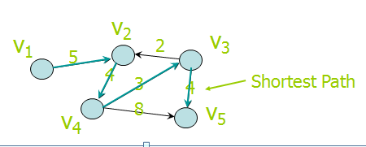

Slide 7
Dijkstra’s algorithm
Consider a graph G, each edge (u, v) has a weight w(u, v) > 0.
Suppose we want to find the shortest path starting from v₁ to any node v_{i}
Let VS be a subset of nodes in G
Let cost[v_{i}] be the weight of the shortest path from v₁ to v_{i} that passes through nodes in VS only.

Slide 8
Example for Dijkstra’s algorithm
v₂
v₁
v₃
2
5
4
3
4
8
v₅
v₄
 | v | VS | cost[v₁] | cost[v₂] | cost[v₃] | cost[v₄] | cost[v₅]
1 |  | [v₁] | 0 | 5 | ∞ | ∞ | ∞
2 | v₂ | [v₁, v₂] | 0 | 5 | ∞ | 9 | ∞

Slide 9
Example for Dijkstra’s algorithm
v₂
v₁
v₃
2
5
4
3
4
8
v₅
v₄
 | v | VS | cost[v₁] | cost[v₂] | cost[v₃] | cost[v₄] | cost[v₅]
1 |  | [v₁] | 0 | 5 | ∞ | ∞ | ∞
2 | v₂ | [v₁, v₂] | 0 | 5 | ∞ | 9 | ∞
3 | v₄ | [v₁, v₂, v₄] | 0 | 5 | 12 | 9 | 17

Slide 10
Example for Dijkstra’s algorithm
v₂
v₁
v₃
2
5
4
3
4
8
v₅
v₄
 | v | VS | cost[v₁] | cost[v₂] | cost[v₃] | cost[v₄] | cost[v₅]
1 |  | [v₁] | 0 | 5 | ∞ | ∞ | ∞
2 | v₂ | [v₁, v₂] | 0 | 5 | ∞ | 9 | ∞
3 | v₄ | [v₁, v₂, v₄] | 0 | 5 | 12 | 9 | 17
4 | v₃ | [v₁, v₂, v₄, v₃] | 0 | 5 | 12 | 9 | 16
5 | v₅ | [v₁, v₂, v₄, v_{3,} v₅] | 0 | 5 | 12 | 9 | 16

Slide 11
Algorithm shortestPath()
n = number of nodes in the graph;
for i = 1 to n
cost[v_{i}] = w(v₁, v_{i});
VS = { v₁ };
for step = 2 to n {
find the smallest cost[v_{i}] s.t. v_{i} is not in VS;
include v_{i} to VS;
for (all nodes v_{j} not in VS) {
if (cost[v_{j}] > cost[v_{i}] + w(v_{i}, v_{j}))
cost[v_{j}] = cost[v_{i}] + w(v_{i}, v_{j});
}
}

Slide 12
Complexity Analysis of Dijkstra Algorithm:
Time complexity: O((V + E) log V), where V is the number of vertices and E is the number of edges.
Auxiliary Space: O(V), where V is the number of vertices and E is the number of edges in the graph.

Slide 13
Applications
It is used in finding Shortest Path.
It is used in geographical Maps.
To find locations of Map which refers to vertices of graph.
Distance between the location refers to edges.
It is used in IP routing to find Open shortest Path First.
It is used in the telephone network.

Slide 14
Huffman Coding
Huffman Coding is a technique of compressing data to reduce its size without losing any of the
details.
It was first developed by David Huffman.
Huffman Coding is generally useful to compress the data in which there are frequently occurring characters.

Slide 15

Working
Let this string is sent over the network:
Each character occupies 8 bits. There are a total of 15 characters in the above string. Thus, a total
of 8 * 15 = 120 bits are required to send this string.
Using the Huffman Coding technique, we can compress the string to a smaller size.
Huffman coding first creates a tree using the frequencies of the character and then generates code
for each character.
Once the data is encoded, it has to be decoded. Decoding is done using the same tree.

Slide 16
Huffman Coding prevents any ambiguity in the decoding process using the concept of prefix
code ie. a code associated with a character should not be present in the prefix of any other code.
The tree created above helps in maintaining the property.
Huffman coding is done with the help of the following steps.

Slide 17
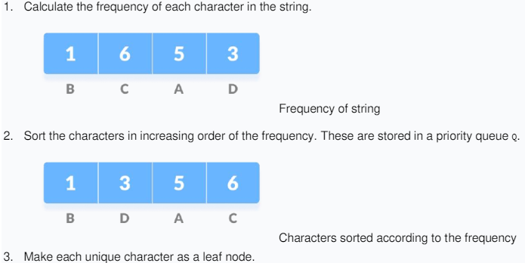

Slide 18
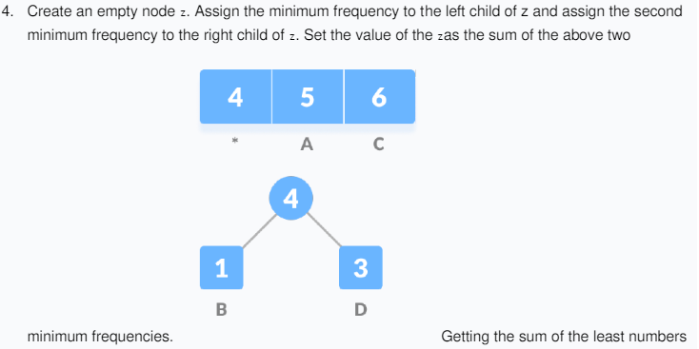


Slide 19
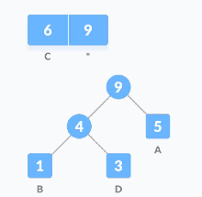
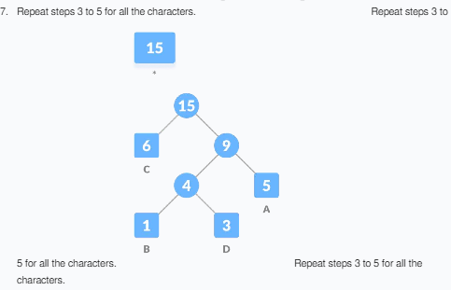

Slide 21
Spanning Tree
Given a connected undirected graph G, a spanning tree of G is a subgraph of G that contains all of G’s nodes and enough of its edges to form a tree.
v₂
v₁
v₃
v₅
v₄
Spanning tree
Spanning tree is not unique!
Notes:
Tell the students some application of spanning tree.

Slide 22
Minimum Spanning Trees
Consider a connected undirected graph where
Each node x represents a country x
Each edge (x, y) has a number which measures the cost of placing telephone line between country x and country y
Problem: connecting all countries while minimizing the total cost
Solution: find a spanning tree with minimum total weight, that is, minimum spanning tree

Slide 23
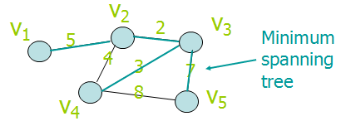
Given a connected undirected graph G.
Let T be a spanning tree of G.
cost(T) = ∑_{e∈T}weight(e)
The minimum spanning tree is a spanning tree T which minimizes cost(T)

Slide 24
Prims algorithms
Algorithm PrimAlgorithm(v)
Mark node v as visited and include it in the minimum spanning tree;
while (there are unvisited nodes) {
find the minimum edge (v, u) between a visited node v and an unvisited node u;
mark u as visited;
add both v and (v, u) to the minimum spanning tree;
}

Slide 25
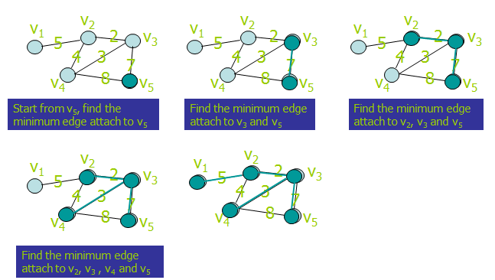

Slide 26
Kruskals algorithms
Let G = (V, E) be the given graph, with | V| = n {
Start with a graph T = (V,) consisting of only the
vertices of G and no edges; /* This can be viewed as n
connected components, each vertex being one connected component */
Arrange E in the order of increasing costs;
for (i = 1, in - 1, i + +)
{ Select the next smallest cost edge;
if (the edge connects two different connected components)
add the edge to T;
}
}

Slide 27
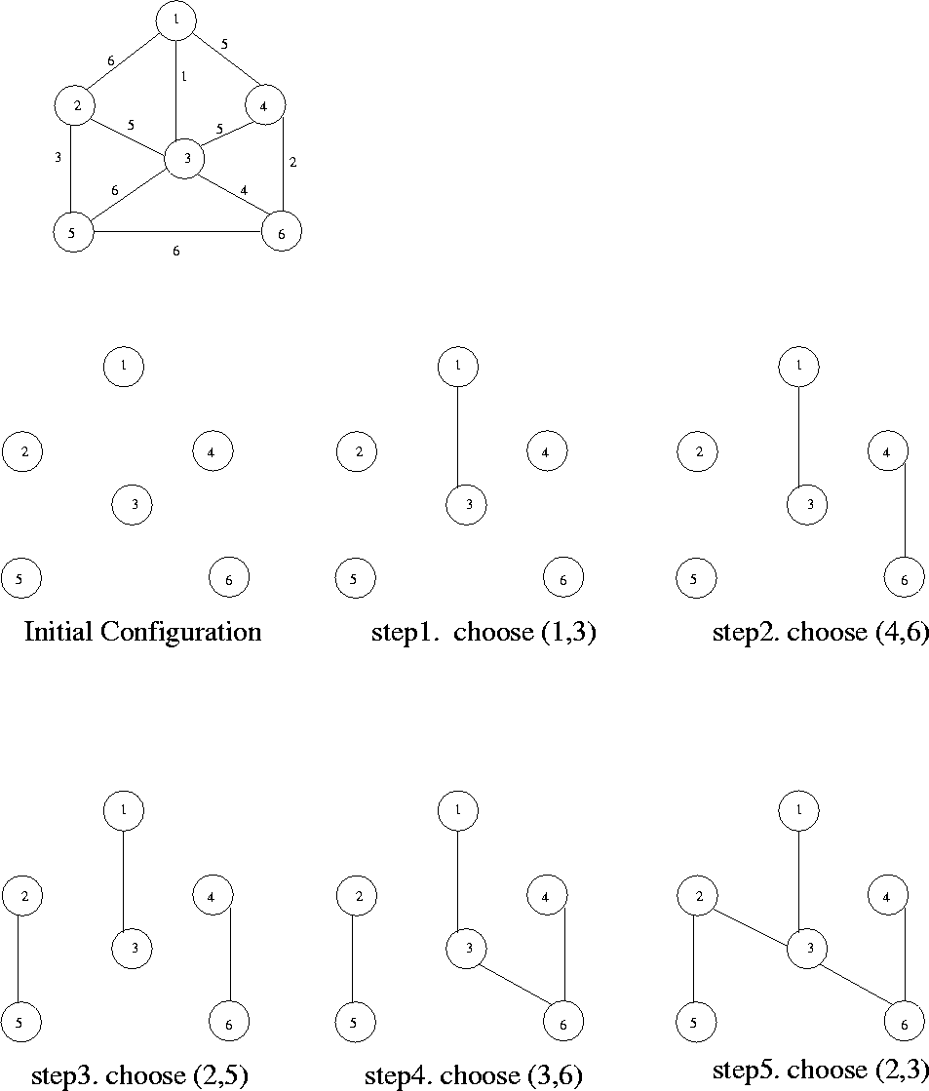

Slide 28
Refer https://visualgo.net/en/mst?slide=1
for better visual understanding of the algorithms.

